Slide 1
Data Cleaning with Pandas
Learning Objectives
Identify missing data and apply techniques to deal with it.
Deduplicate, transform and replace values.
Use DataFrame string methods to manipulate text data.
Write regular expressions which munge text data.
Expected Prior Knowledge
Experience of working with data using Data Analysis tools such as Excel.

Slide 2
Missing Values

Slide 3
Accuracy
Completeness
Uniqueness
Timeliness
Validity
Consistency
Data Quality Dimensions

Slide 4
Missing Values

Slide 5
What is the problem with missing data?
How do we deal with missing it?
There are three main options:
Removal
Imputation – requires skill
Leave as is; some models can deal with missing values
Missing Values
Notes:
Removal
If we have data with some missing fields it may be best to just remove those values, i.e delete the rows with missing fields
What are the pros and cons of this approach?
Pros:
Its very easy to do
Do not have to worry about approaches to imputation
Is generally chosen when we have more than enough data to build our model
Cons:
We lose information
May not be the best approach if don’t have “very much” data
Imputation:
Pros
Keep more of the data
The missing values may be important to the model
Cons
Can be a complicated process, lots of things to consider:
How are the values missing?
Should we worry about them? Are they important values
How should be generate this data, if we should?
Leave as is:
Some models handle missing values well, (such as certain types Decision Trees, Random Forests, and Naive Bayses approaches)
Other models do not handle them well and decision must be taken, removal or imputation.

Slide 6
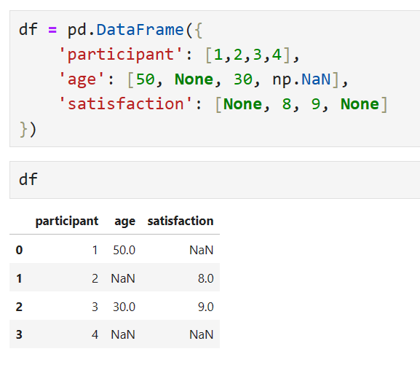
Pandas represents all missing values as NaN
None will be converted to NAN
Representing Missing Values
Notes:
The primary way in which Pandas represents missing values is by using the numpy float value NaN. This is used to represent all kinds of missing value in Python, and replaces python None values.
There is no distinction between values missing (NA in R), numerical overflow (NaN in R), or empty objects (NULL in R).

Slide 7
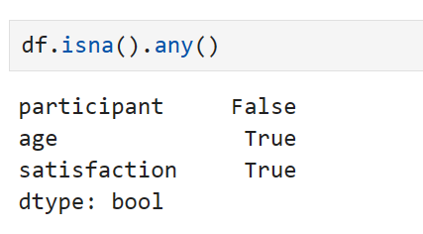
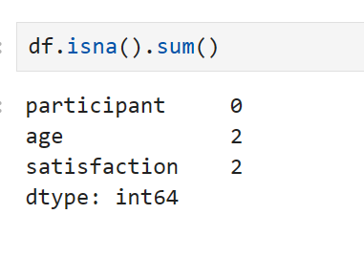
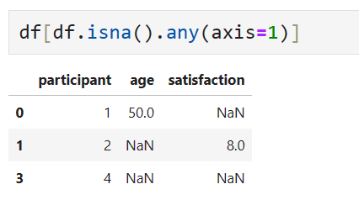
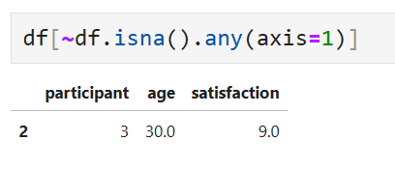
Finding Missing Values
Notes:
Missingness is something often encountered when working with data, and pandas has many methods for finding missing values. This can be a simple test as to whether a row contains NaN values, or a specific search for the indices where the exist. Some of the core methods are detailed above.

Slide 8
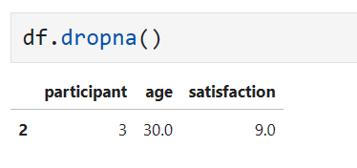
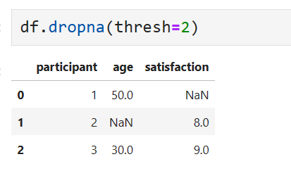
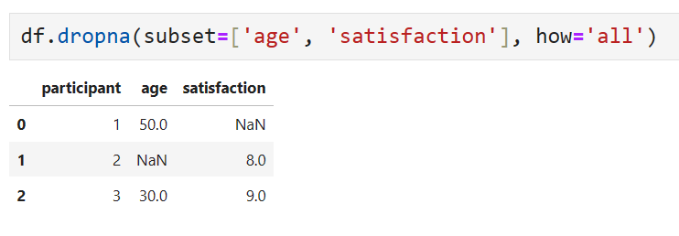
Deleting Missing Values
Notes:
To remove null values, we typically use the dropna method.

Slide 9
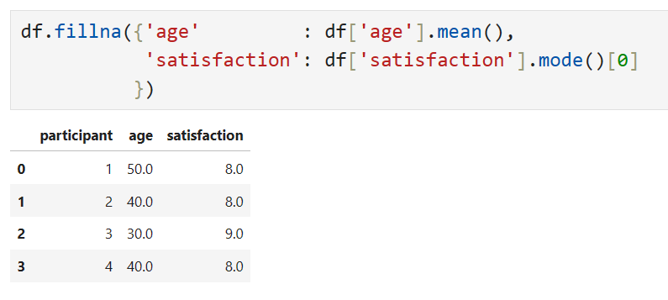
Filling in Missing Values
If filling in values, *it is common to use an average
Use fillna to specify a value to replace each NaN with which depends on the column where it is found
Notes:
To fill in missing values, we use the fillna mehod. Fillna replaces null values with either a single value, or a value specified for a specific index, which can be derived by applying a function to the Dataframe.
It is also possible to use backward & forward filling, approaches often used when working with time series, to fill in missing values with the last or next observed non-null value.

Slide 10
Deduplication

Slide 11
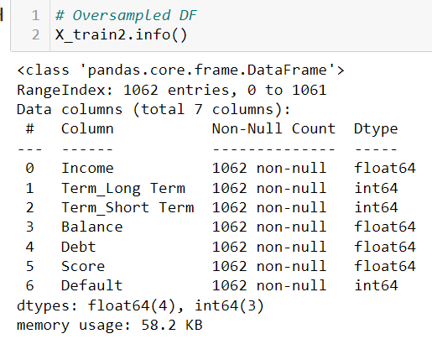
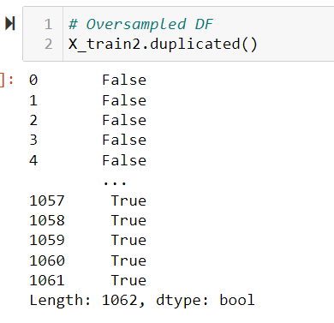
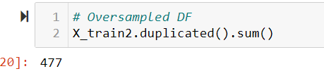
Duplicates
Notes:
It is easy to find duplicates in Pandas
df.duplicated() gives us a Boolean telling us if a row has a duplicate within the data.
We can sum these to see how many rows are duplicated.
We can see that in this case we have 477 duplicate rows in the data frame.
By default the first appearance of a duplicate term is classed as false.
We can also use the Boolean array to display all of the duplicates, shown in the next slide

Slide 12
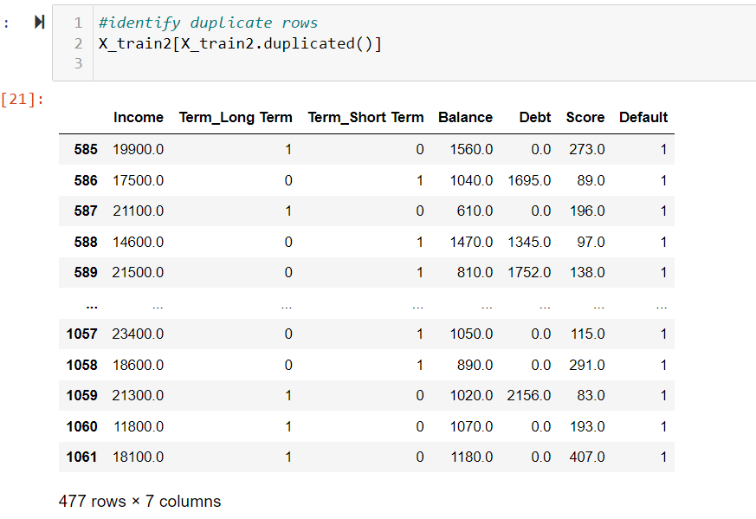
Identifying duplicates
Notes:
Using duplicated, we can select the rows which have been deemed duplicate by value for inspection.
These duplicates can easily be dropped as shown in the next slide.

Slide 13
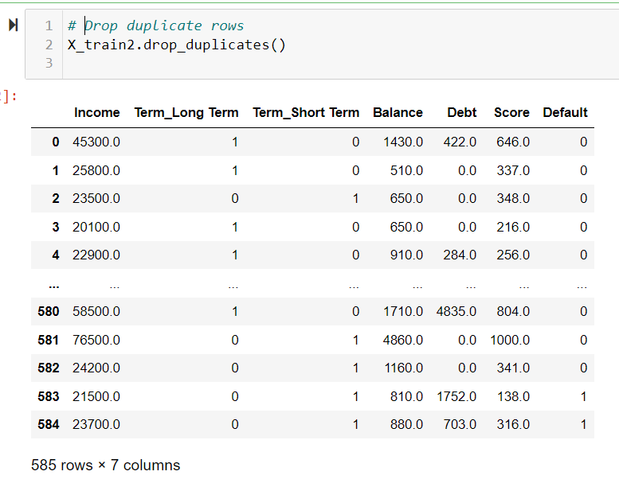
Removing
duplicates
Notes:
Drop duplicates gets rid of those rows deemed to be duplicates, but keeping the first occurrence of the duplicate row. This can be altered by changing the keep parameter.

Slide 14
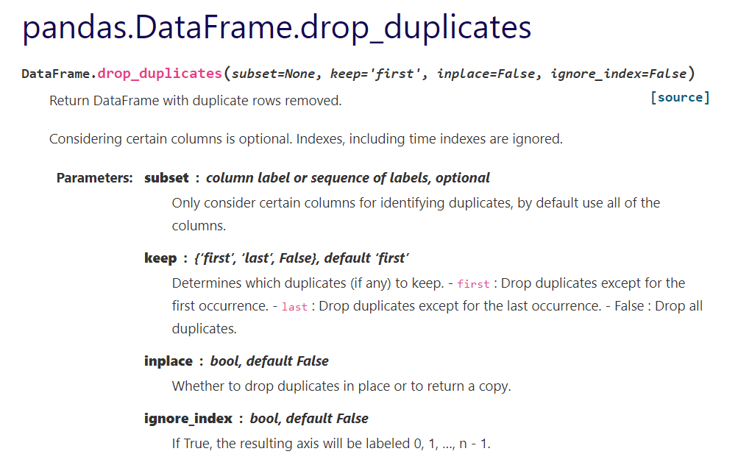
Pandas documentation for the method
Notes:
As with most methods in Pandas we have flexibility,
W can define which columns to include, whether to define the first, last or all duplicates as true
Ask what the difference is between all options especially ‘inplace’ and ‘ignore_index’
If inplace = True, nothing will be returned, the original datframe will be altered
If inplace = False a new dataframe will be returned with the duplicates removed and this can be assigned
Ignore index
When we remove duplicates the rows removed will take their index with them, so we will have gaps.
We can reset this index or keep it as is.
The index may hold information about the data we want to keep, or it may be arbitrary.

Slide 15
Data Transformation

Slide 16
We often want to change how we represent data
This could involve:
Replacing some values with others
Binning continuous variables
Deriving new columns
Applying functions
Data Transformation

Slide 17
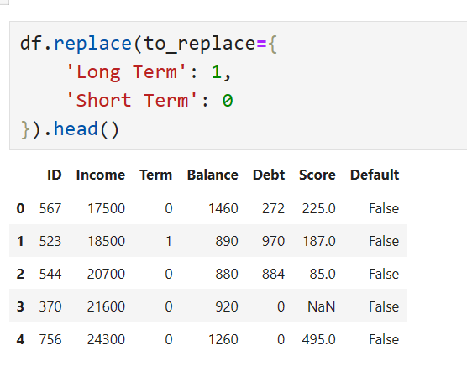
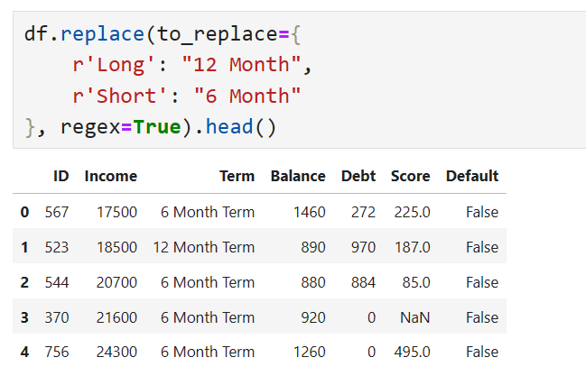
Replacing Values
Notes:
Replace can be used to implement a simple search and replace, as well as switch out a specific set of values for others. It requires two parameters to be passed – the values that are to be replaced, and what those values are to be replaced with. This can be passed as a single dictionary or as two parameters. Interestingly, regex patterns can be used to select values that are to be replaced.
Similarly, we can use the map method, passing in a dictionary to be used to replace values.

Slide 18
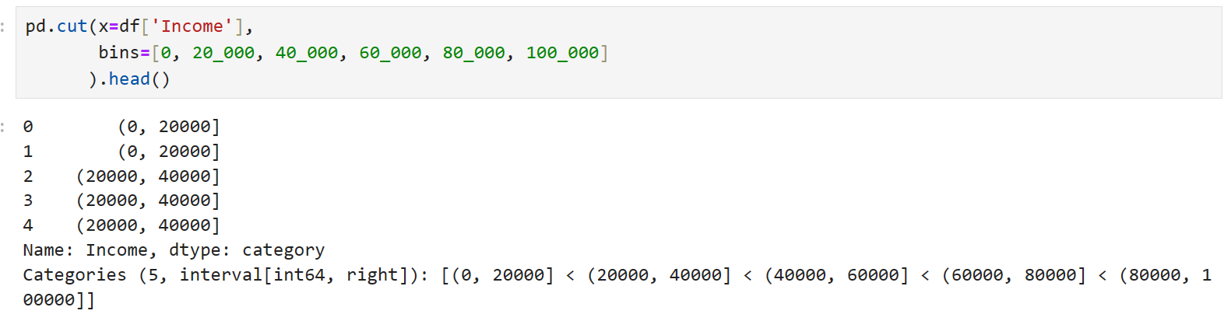
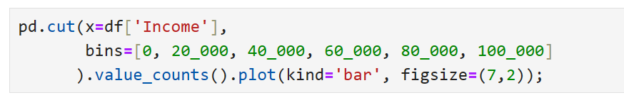
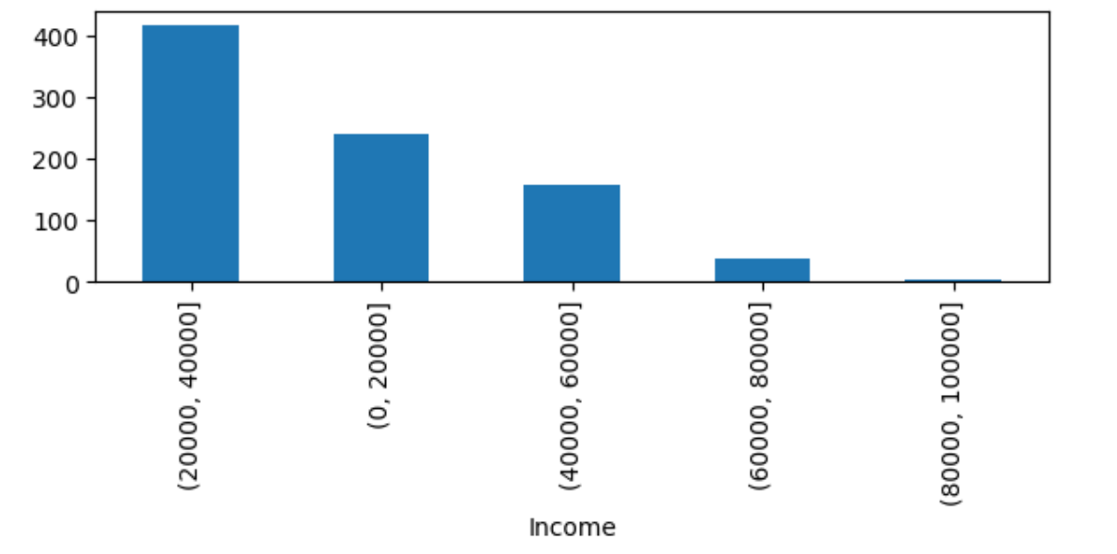
Discretisation & Binning
Notes:
The pandas function cut can be used to bin values. It requires a list specifying bin ranges to be passed as well as the Series to be binned. By default, the upper bound of each bin is inclusive, though this can be altered by setting right=False.
For quantile based binning, qcut can be used.
Bins can be used in conjunction with value_counts to produce specific subgroup counts, and can easily be passed to a plotting module.

Slide 19
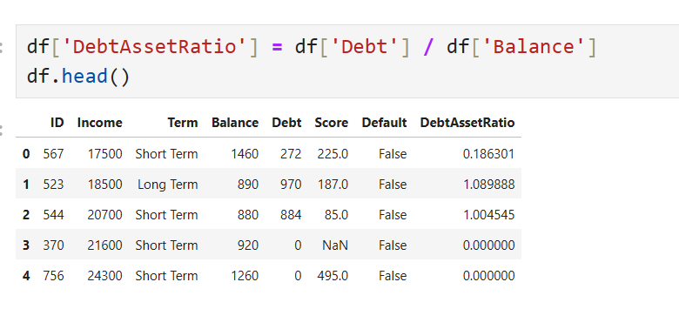
Deriving new Columns
Notes:
If you want to add a column to your dataframe that has been derived from one or more others, it is done using a simple assignment syntax.
Because operations between columns and methods over columns are applied element-wise, most will result in a series or DataFrame with the same number of rows as the Dataframe ther are derived from.

Slide 20
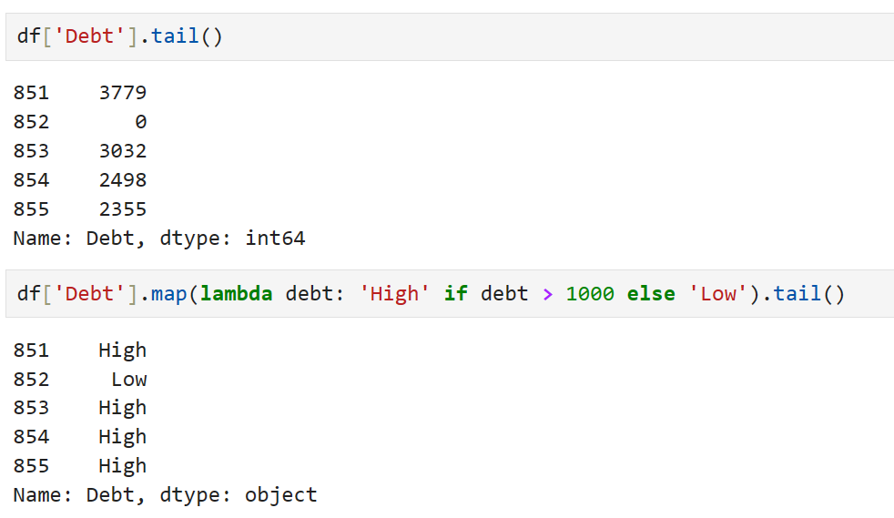
Applying Functions over columns
Notes:
Pandas has a number of methods which allow functions to be applied over Series & DataFrames. Functions generally just have to take in a column element, but can be defined so as to allow further parameters to be passed.
Map can be used to substitute each value in a Series or DataFrame with another value.
Apply can be used to project more complex functions over a DataFrame, either row or column-wise, and can yield values, series, or sets of columns to be inserted into the Dataframe.

Slide 21
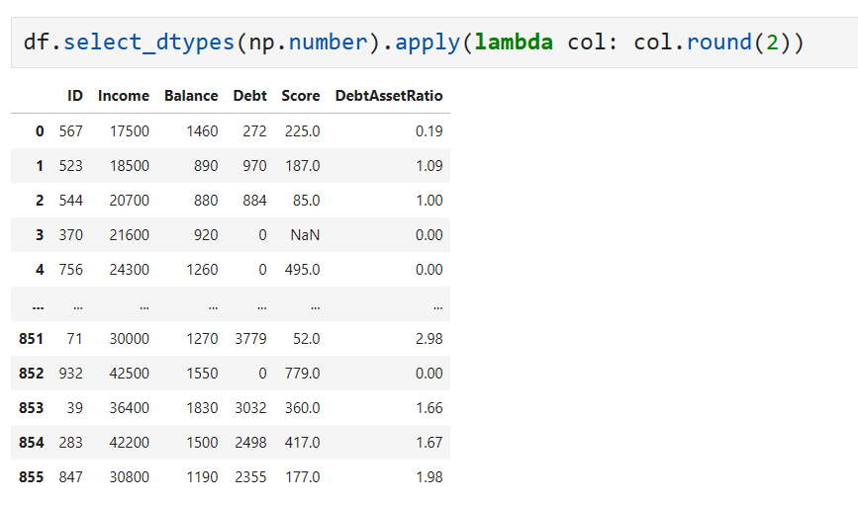
Applying Functions over columns
Notes:
Pandas has a number of methods which allow functions to be applied over Series & DataFrames. Functions generally just have to take in a column element, but can be defined so as to allow further parameters to be passed.
Map can be used to substitute each value in a Series or DataFrame with another value.
Apply can be used to project more complex functions over a DataFrame, either row or column-wise, and can yield values, series, or sets of columns to be inserted into the Dataframe.

Slide 22
Working with Text Data

Slide 23
Text data provides unique challenges, and needs specific processing & preparation
Pandas can use Pythons string methods
Pandas also implements regular expression functions
These allow you to do anything with text!
Text Data

Slide 24
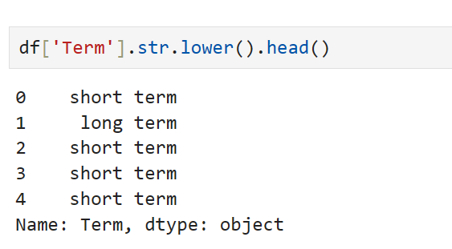
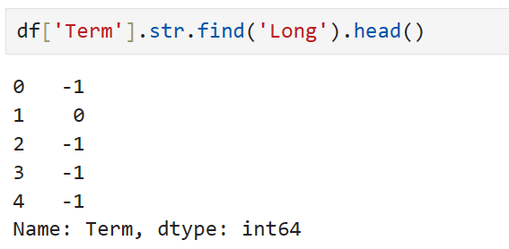
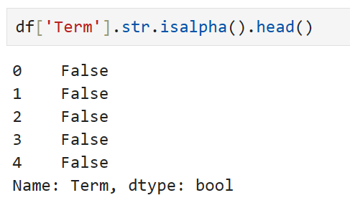
String Methods
Notes:
Pandas has an interface to Pythons string methods which allows all to be applied elementwise over String like columns.

Slide 25
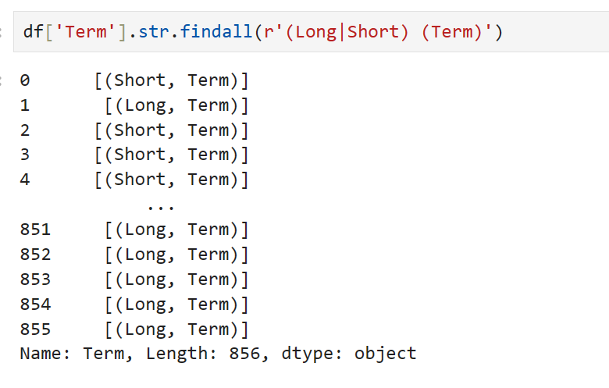
Regular Expressions (Regex)
Notes:
Regular expressions provide an extensive text search language which we do not intend to teach here. This can be especially useful when munging text data.
We can apply regex search and replace functions also using the str interface. For example findall can be used to identify all parts of a string which match a pattern, and can be applied row-wise over the DataFrame.

Slide 26
Elementary extended RE meta-characters
. match any single character
[a-zA-Z] match any char in the […] set
[^a-zA-Z] match any char not in the […] set
^ match beginning of text
$ match end of text
x? match 0 or 1 occurrences of x
x+ match 1 or more occurrences of x
x* match 0 or more occurrences of x
x{m,n} match between m and n x’s
abc match abc
abc|xyz match abc or xyz
Character
Classes
Anchors
Quantifiers
Alternation

Slide 27
06_Data_Cleaning_with_Pandas_Exercise.docx
Exercise

Slide 28
Learning check
Think about your answers to these questions
Why do we treat missing data. How can we do it with Python?
Which Python functions can we use to identify duplicates?
How can we alter column values?
How can we process text using Pandas?
What are regular expressions?

Slide 29
How did you get on?
Learning Objectives
Identify missing data and apply techniques to deal with it.
Deduplicate, transform and replace values.
Use DataFrame string methods to manipulate text data.
Write regular expressions which munge text data.

